Slide 1
Grasping Textual Relation
Teacher Anothai Wannathong
SRINAGARINDRA THE PRINCESS MOTHER SCHOOLPHUKET
Under the Royal Patronage of Her Royal Highness Princess MahaChakriSirindhom

Slide 2
Grasping Textual Relation
LEXICAL COHESION
GRAMMATICAL COHESION

Slide 3
Grasping Textual Relation
LEXICAL COHESION
In this type the sentences are related through VOCABULARY by :

Slide 4
Grasping Textual Relation
a. Repeating the words or phrases
Birds are also animals that have backbones. Birds are of many different kinds, sizes, colors, and shapes, yet they are all alike in certain ways that help us to identify them as birds. All birds have feathers…….

Slide 5
Grasping Textual Relation
b. Using synonyms or near synonyms
Reading is a primary avenue to knowledge. For some the path is wide, paved straight with all road signs where they should be.

Slide 6
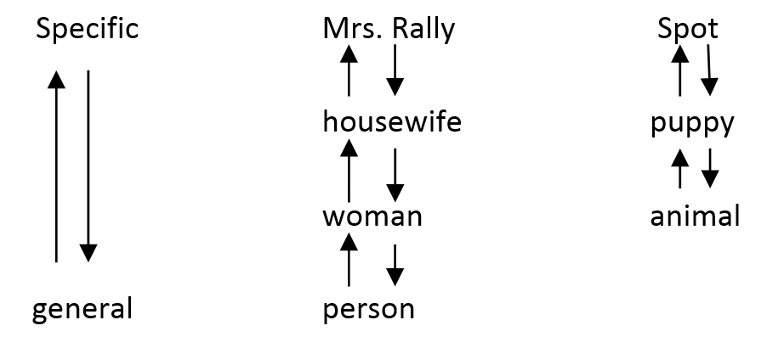
Grasping Textual Relation
c. Using a more general term to refer to the thing, action, etc, that has already been mention earlier, and voice versa.

Slide 7
Grasping Textual Relation
c. Using a more general term to refer to the thing, action, etc, that has already been mention earlier, and voice versa.
Nancy , who is in the fourth grade, does not feel good today. The poor girl has a sore throat. Since it is a rainy day, the child probably caught cold on her way to school.

Slide 8
Grasping Textual Relation
GRAMMATICAL COHESION
In this type the sentences are related through the use of

Slide 9
Grasping Textual Relation
a. Pronouns : he, his, him, they, their, them, ……etc.
A baby elephant is the biggest of all land babies. A newborn baby weighs more than two hundred pounds. It is about three feet high. The new baby is
strong, too. Almost as soon as it is born, it can walk about.

Slide 10
Grasping Textual Relation
b. Demonstratives : this, these, that, those, here and there.
He broke his left leg a week ago. This kept him from joining the
camping trip.

Slide 11
Grasping Textual Relation
c. Comparatives
Tom weighed 60 kilos. His brother weighed one kilo less, but his sister weighed more.

Slide 12
Grasping Textual Relation
d. Summary words : process, procedure, measure, problem, idea, definition, quality
She is clever, gentle and kind-hearted. These are the qualities which attracted everyone around her.

Slide 13
Grasping Textual Relation
e. Noun / Verb Substitutes : so, one, not, do, does
. Larry passed the test, but not Kim.
. I enjoy playing badminton. My husband does, too.

Slide 14
EXERCISE 1.
Country homes and city homes in Japan can be quite different, just as they can be in the United States. Japanese who live in the country usually have small, one-story homes with from one to four rooms. These rooms are separated by sliding paper screens which act as doors and walls. Most city people have at least one Western-style room. These Japanese generally live in apartments. Their apartments are heated by gas or oil and have thicker walls than do the country homes.
a. Japan
c. Room
b. Japanese
d. Apartment

Slide 15

Correct

Slide 16
✗
Incorrect

Slide 17
EXERCISE 2
Most people think that home is the safest place of all. They are wrong. Carelessness has made the home a dangerous place. Safety experts say that more people are injured in homes than in factories, mines, or on farms. Nearly every home accident occurs, safety add, because someone carelessly breaks a simple rule of safety.
a. Most people
c. Dangerous
b. Home
d. Safety Place

Slide 18

Correct

Slide 19
✗
Incorrect

Slide 20
EXERCISE 3
Buffaloes have had many enemies. The Indians hunted them for food and clothing. The pioneers going west killed them for their skins as well as for their meat. Coyotes often creep up on a herd of buffaloes, hoping to catch a young or weak one. Now although they have been cared for and protected, hunters still kill them for their skins and their horns.
a. enemies
c. Coyotes
b. food
d. Buffaloes

Slide 21

Correct

Slide 22
✗
Incorrect

Slide 23
Grasping Textual Relation
นักเรียนเข้าใจแล้วใช่ไหมค่ะ เก่งมากค่ะ ถ้ายังไม่เข้าใจลองฝึกอีกครั้ง นะค่ะ

